Slide 1
Recovery from Whistleblowing
Michael Cole
Whistleblowers Australia Conference 2014

Slide 2
Recovery from Whistleblowing
Basically it is recovery from PTSD

Slide 3
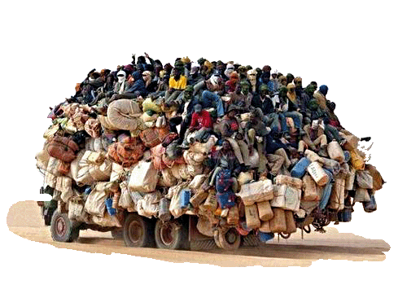
Recovery from Whistleblowing
Feeling Overloaded?

Slide 4
PTSD
Common Symptoms
Suffering from bad dreams
Experiencing uncontrollable thoughts
Avoiding places that remind one of the event
Feeling worried, guilty, or sad
Sleeping too little or too much
Feeling on edge
Fighting with loved ones
Feeling alone

Slide 5
Recovery from Whistleblowing
Four Wheels on the Rolls Royce of Recovery
Physical
Psychological health
Purpose and Trajectory
Medication

Slide 6
Recovery from Whistleblowing
Four Wheels on the Rolls Royce of Recovery
Physical
Exercise
Sleep Hygiene
Eating

Slide 7
Recovery from Whistleblowing
Four Wheels on the Rolls Royce of Recovery
Psychological health
Thought patterns
Thinking time
Family
Support systems
Spiritual
Forgiveness

Slide 8
Recovery from Whistleblowing
Four Wheels on the Rolls Royce of Recovery
Purpose and Trajectory
Find a purpose
Set life on a trajectory
Leave the old ‘purpose’ or ‘no purpose’ behind

Slide 9
Recovery from Whistleblowing
Four Wheels on the Rolls Royce of Recovery
Medication
16.6% of Australians will suffer anxiety disorder sometime in their lives
If you had diabetes you would treat it (for life if necessary) wouldn’t you?
Find the right dose of the right drug

Slide 10
Recovery from Whistleblowing
Just because you’re paranoid
doesn’t mean they’re
not out to get you.

Slide 11
Recovery from Whistleblowing
Whistleblowers:
are driven by altruism.
are generally moralistic, becoming committed and even obsessed.
emphasize rights.
are stubbornly committed and uncompromising.
are willing to go against social conventions.

Slide 12
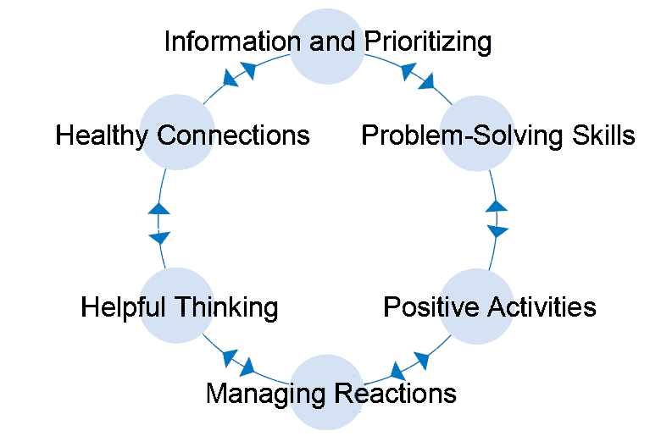
Recovery from Whistleblowing Skills for Psychological Recovery Training

Slide 13
Recovery from Whistleblowing Skills for Psychological Recovery Training
http://www.ptsd.va.gov/professional/materials/manuals/skills_psych_recovery_manual.asp
PRT

Slide 14
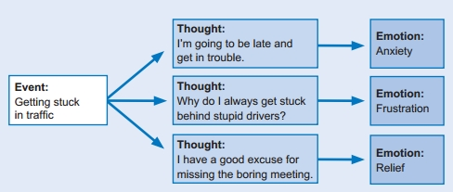
Recovery from Whistleblowing Skills for Psychological Recovery Training

Slide 15
Recovery from Whistleblowing Skills for Psychological Recovery Training
Strengthens family relationships
Emphasizes family needs
Focuses on problem-solving
Relationship building
Old vs. new values
Establishes a meaning for the event

Slide 16
Recovery from Whistleblowing
Where there is life there is hope

Slide 17
Recovery from Whistleblowing
Westmeadhospitalwhistleblowers
resources-and-help

